Slide 1
USING OCR TO EXTRACT TEXTUAL DATA FROM BURIAL RECORDS
PRESENTED BY:
CRAIG PERKINS AND KWAME NANI
NORTHEASTERN UNIVERSITY
June 2021 – EAI6020

Slide 2
INTRODUCTION
To extract text characters from the Burial records we employed the OCR technique, which will be discussed later in our presentation.
LABELS COMMON IN ALL BURIAL FORMS :
Decedent- Name of deceased person
Burial Location Information – Section, Lot and Grave Number
Date of Burial
Age

Slide 3
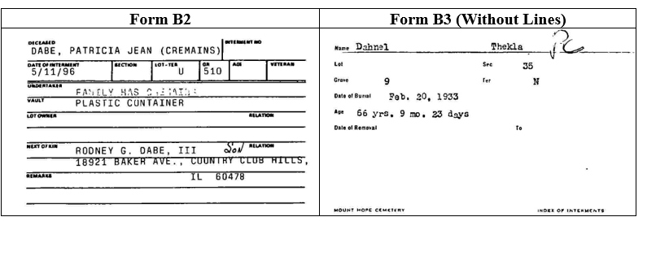
DEMONSTRATION

Slide 4
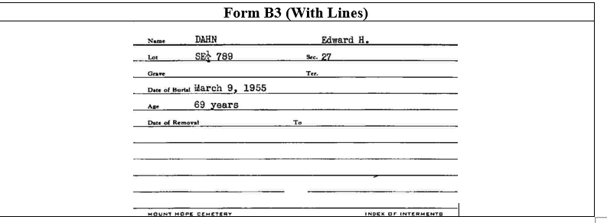
DEMONSTRATION

Slide 5

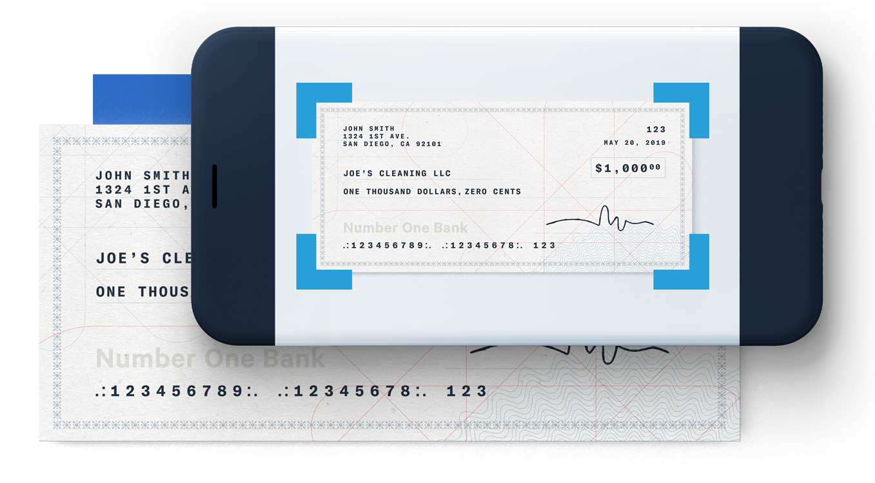
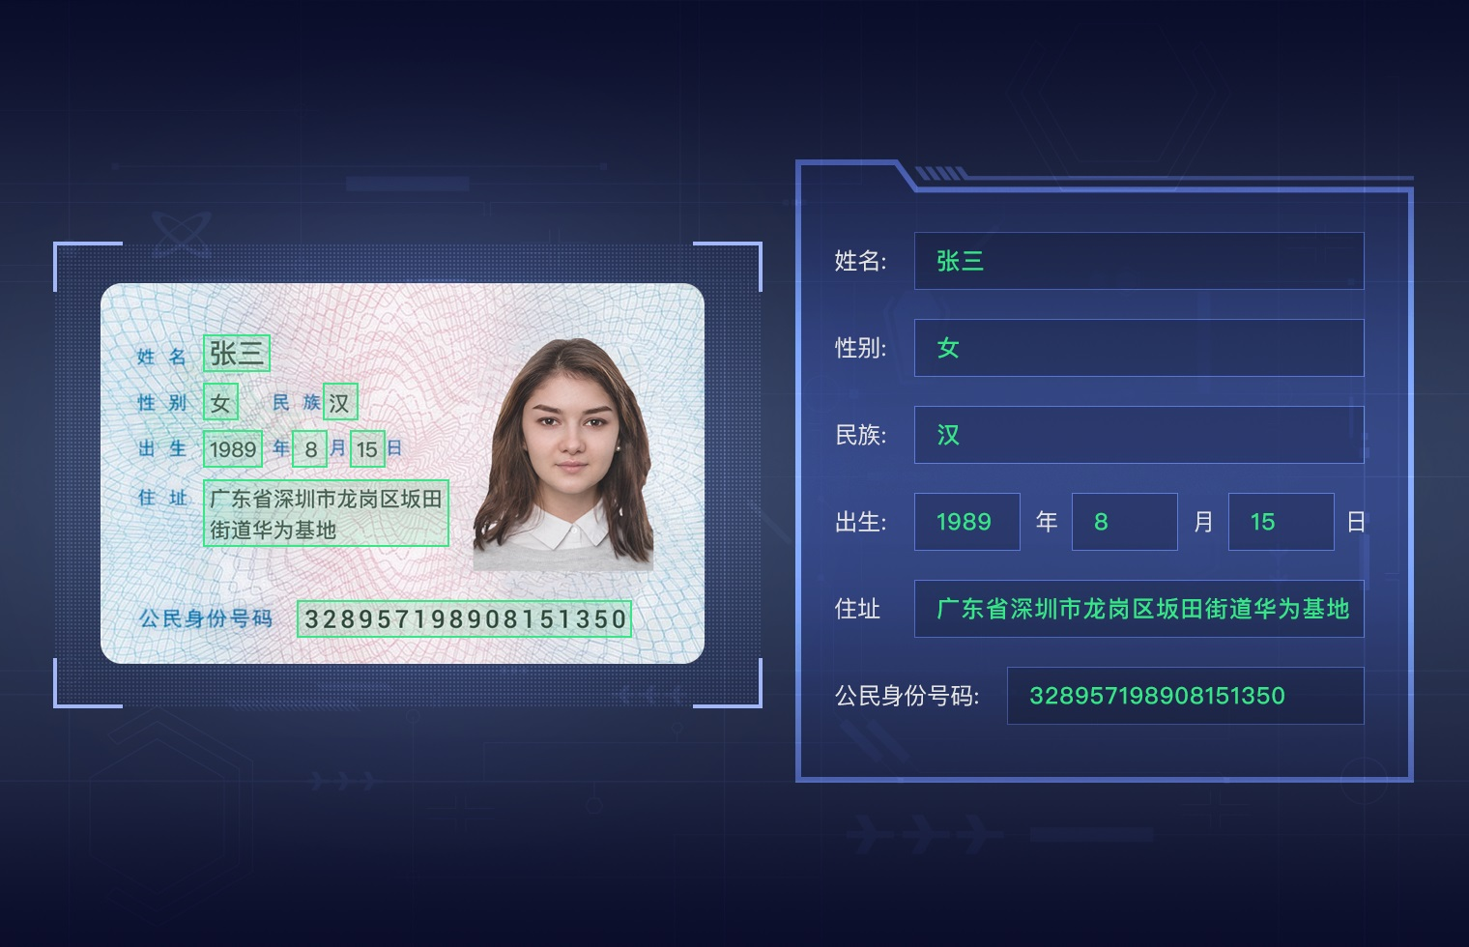
BACKGROUND OF OUR TECHNIQUE
OCR stands for Optical Character Recognition which is a technology to recognize text inside images such as scanned documents and photos and videos.
A few applications include:
Google Lens Mitek’s Mobile Check Deposit Huawei’s Passport OCR

Slide 6
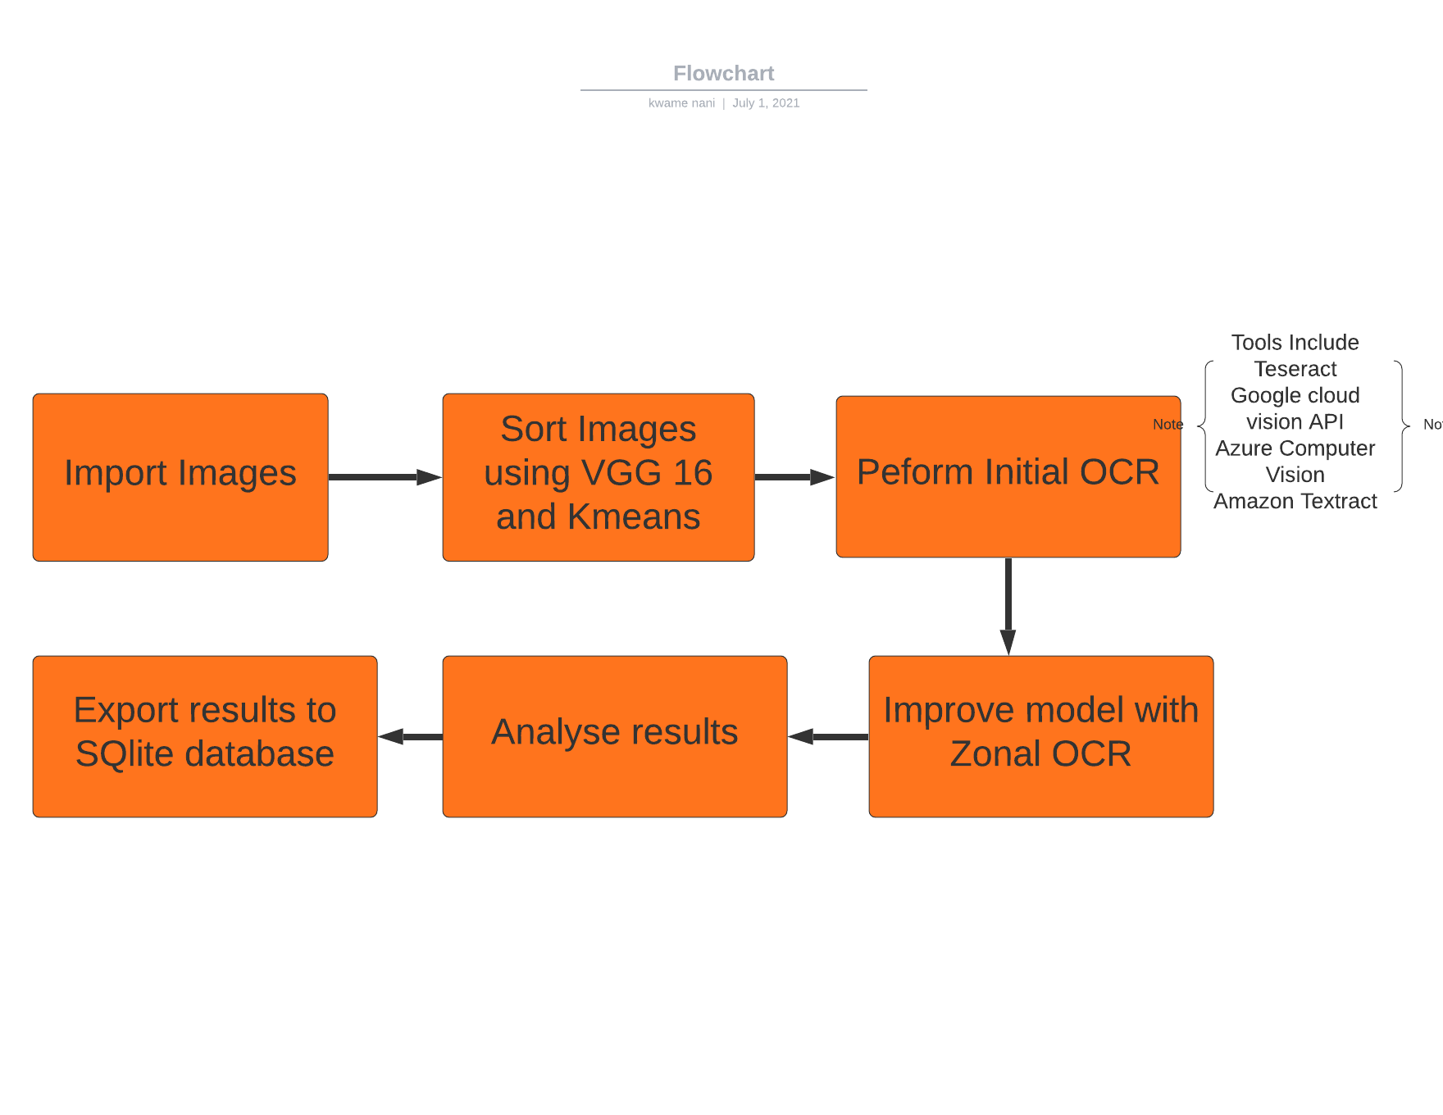
WORKFLOW OF OUR PROJECT

Slide 7
SORTING OUR IMAGES USING VGG 16 AND K MEANS
VGG 16 is a very efficient CNN architecture that has historically achieved an astounding accuracy of 92.7% classifying ImageNet a dataset of 14 million images into 1000 categories.
Just like every CNN architecture it has two functional layers: Convolutional and Pooling layer.
In the Convolutional layer a dot product operation is performed on the array of our input image data and a filter, this same filter is multiplied by the input array multiple times at different points on the input. The filter then detects specific features across the three different types of image data in operation.
In the Pooling layer the dimensions of the feature maps created in the convolutional layer are reduced so there are fewer parameters to learn from and fewer computations performed.

Slide 8
SORTING OUR IMAGES USING VGG 16 AND K MEANS
At this point each of the three types of documents earlier identified have specific features that have been identified by our convolutional layer and parameters summarized by our pooling layer, VGG 16 however has 1000 categories to classify our images into. Also, it has 138 million parameters already built in its architecture making feature mapping of these documents relatively easy.
We now group similar images whose features have been detected with a k means clustering algorithm.

Slide 9
HOW DOES OCR EXTRACT TEXT CHARACTERS FROM THE BURIAL RECORDS?
Tesseract which is the package we used understands different image formats. In the case of the records JPEGS.
Next step is identifying the most important features of our images such as resolution and inversion. Except the handwritten documents all documents had a predefined font so working on them were quite straightforward.
Lines detection and removal. This step is required to improve page layout analysis, to achieve better recognition quality for underlined text, to detect tables, etc.
The OCR system will have to detect important area in our document to perform text extraction on which is known as Zoning(more to be discussed on this later).

Slide 10
HOW DOES OCR EXTRACT TEXT CHARACTERS FROM THE BURIAL RECORDS?
Recognition of characters, an image of every character will have to be converted into the appropriate character code .
Dictionary Support, this is a very important step since similar text characters are distinguished at this point, characters like "1" and "I", "C" and "G“ are very similar and the dictionary support helps distinguish them.
Lastly, the results of the extraction is saved in appropriate file formats like pdf ,txt ,csv etc.

Slide 11
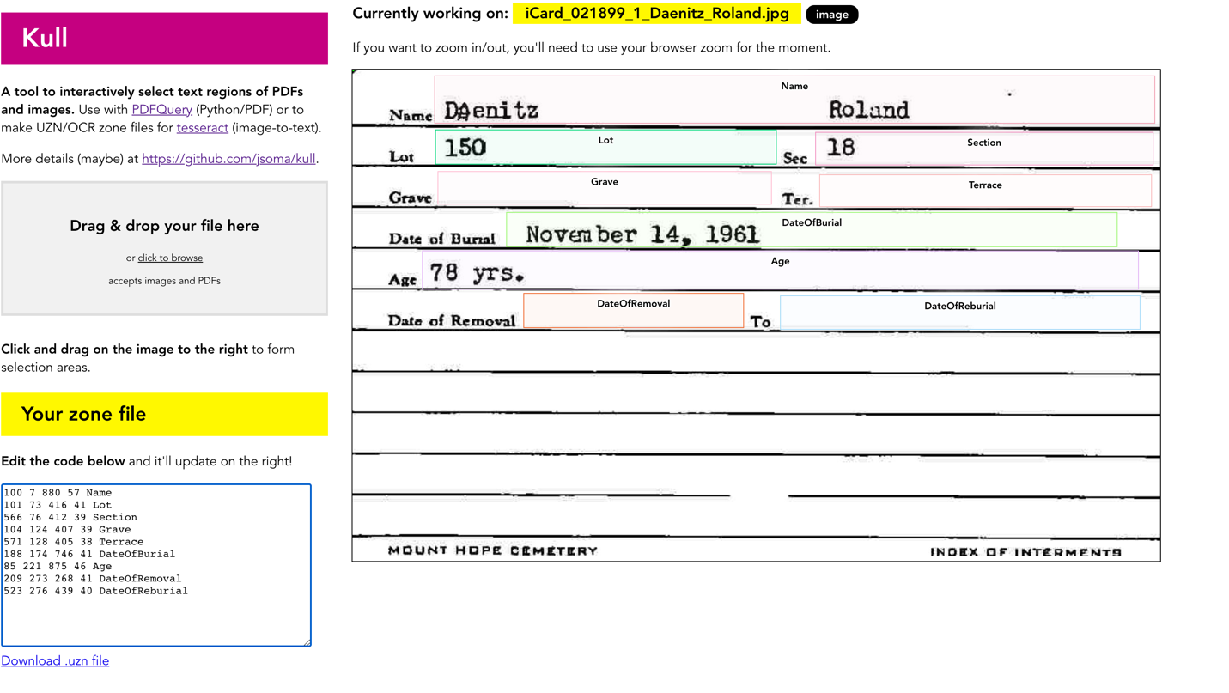
IMPROVING OUR MODEL WITH ZONAL OCR
To improve our model, we used a tool called Kull, which is a text region selection tool for images and PDF to select regions in our document we will want to extract texts from. Employing this approach we realized a huge improvement in our accuracy. scores.

Slide 12
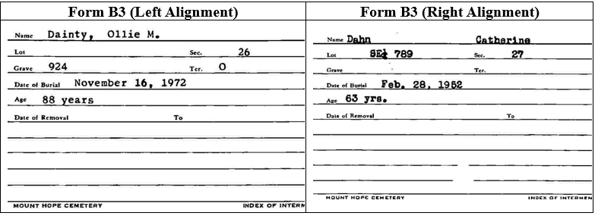
ANALYSIS OF RESULTS
We found a number of transcriptions indicating that there was a Date of Reburial which is the ‘To’ column in Form B3 indicating that a body was reburied after being exhumed. To our surprise we realised that this was as a result of an alignment issue. The word ‘To’ is on the right side of Ter on the form on the right and on the left side of Ter on the form of the left.

Slide 13
ANALYSIS OF RESULTS
Tesseract was trying to recognize non-ascii characters, there may certainly be non-ascii characters in the data and we wanted to see if it would improve the recognition more if we set a character whitelist to pytesseract and we did notice modest improvements.
We tried to determine if we should remove words with a confidence level below a given threshold, but ended up keeping all the transcribed words in. We came across instances where Tesseract gave a confidence of 0, but the transcription was correct so we would also take a deeper dive into how tesseract computes the confidence if we had more time.
Some margins were not equal and that impacted our Zonal OCR. To solve this issue we tried to normalize and remove the margin to make the samples in the cluster as uniform as possible.

Slide 14
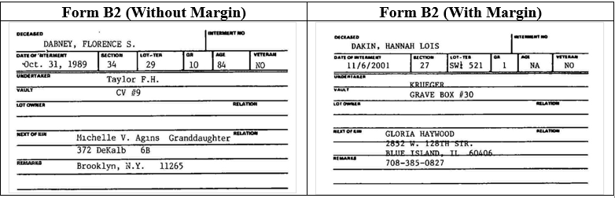
ANALYSIS OF RESULTS
Form B2 on the right has a wider margin than that of the left.

Slide 15
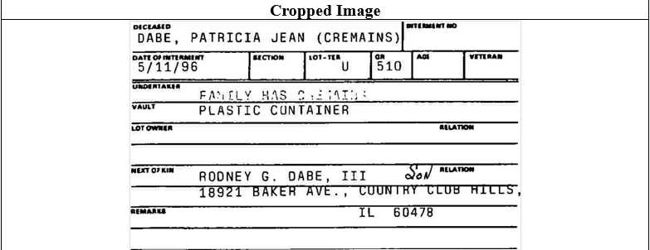
ANALYSIS OF RESULTS
After removing the margins the OCR performed much better.

Slide 16
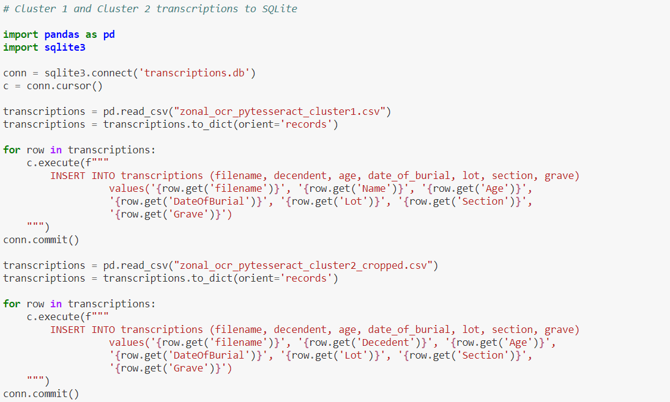
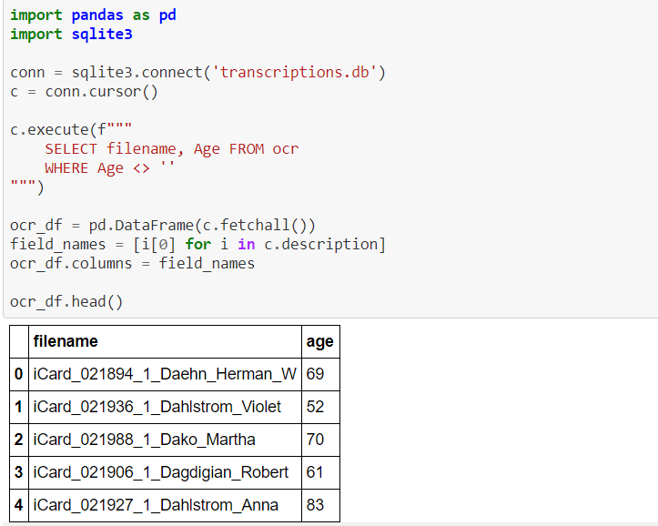
EXPORTING AND CLEANING DATA
We wrote a python script to process the csv and insert data into SQLite so that we could attempt to get better structured dates and other data points.

Slide 17
EXPORTING AND CLEANING DATA
We wanted to detect anomalies in our data, so additional checks were put in place to prevent ages over 130 from entering our database .
One of the insights was to determine the average age of the deceased buried in the cemetery. To answer this, we ensure that we stored the Age as a number in the database so that we could perform SQL aggregation functions when asking questions on the dataset.

Slide 18
FUTURE WORK
Inasmuch as Zonal OCR, has proven to be very efficient if we want to scale this solution, we will have to set up preprocessing pipelines to crop margins out of images and denoise the images to improve transcription.
We will have to research more on advanced clustering techniques to identify forms that have misaligned fields so that human intervention is minimal as possible.

Slide 19
CONCLUSION
This project was a great way to get situated with existing OCR technologies and exercise our creativity in trying different methods of obtaining the highest level of accuracy in the process.
Creating structured data from unstructured sources is a big data mining challenge and enables us to use a variety of other algorithms once we’ve achieved a good amount of structure.
Looking at the earlier issues we faced we can’t run this system in a fully autonomous manner and will need human intervention to rectify problems that may come up in this operation.

Slide 20
REFERENCES
1. Improve OCR Accuracy With Advanced Image Preprocessing - https://docparser.com/blog/improve-ocr-accuracy/
2. Amazon Textract - https://aws.amazon.com/textract/
3. Google Cloud Vision API - https://cloud.google.com/vision/docs/ocr
4. Azure Computer Vision - https://azure.microsoft.com/en-us/services/cognitive-services/computer-vision/
5. Tesseract - https://github.com/tesseract-ocr/tesseract
6. Google Lens can translate foreign language text in photos and read it back to you - Techcrunch
7. Mitek Systems – Mobile Deposit - https://www.miteksystems.com/mobile-deposit
8. ABBYY – Mobile Capture for Banking - https://www.abbyy.com/blog/ocr-sdk/mobile-capture-for-mobile-banking/
9. Huawei – Passport OCR - Huawei Cloud

